Slide 1
Genetics (Mendelian vs Non-Mendelian inheritance)
파이썬을 이용한 Bioinformatics 기초 PARTⅡ
Woosung Chung
2014.08.26

Slide 2
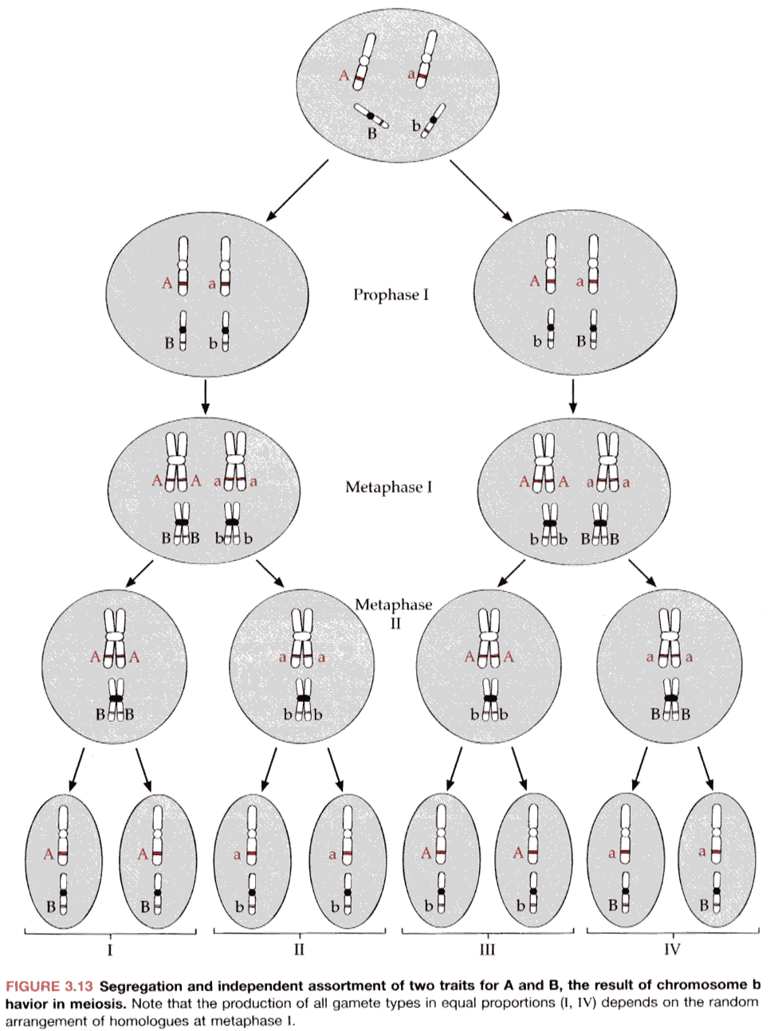
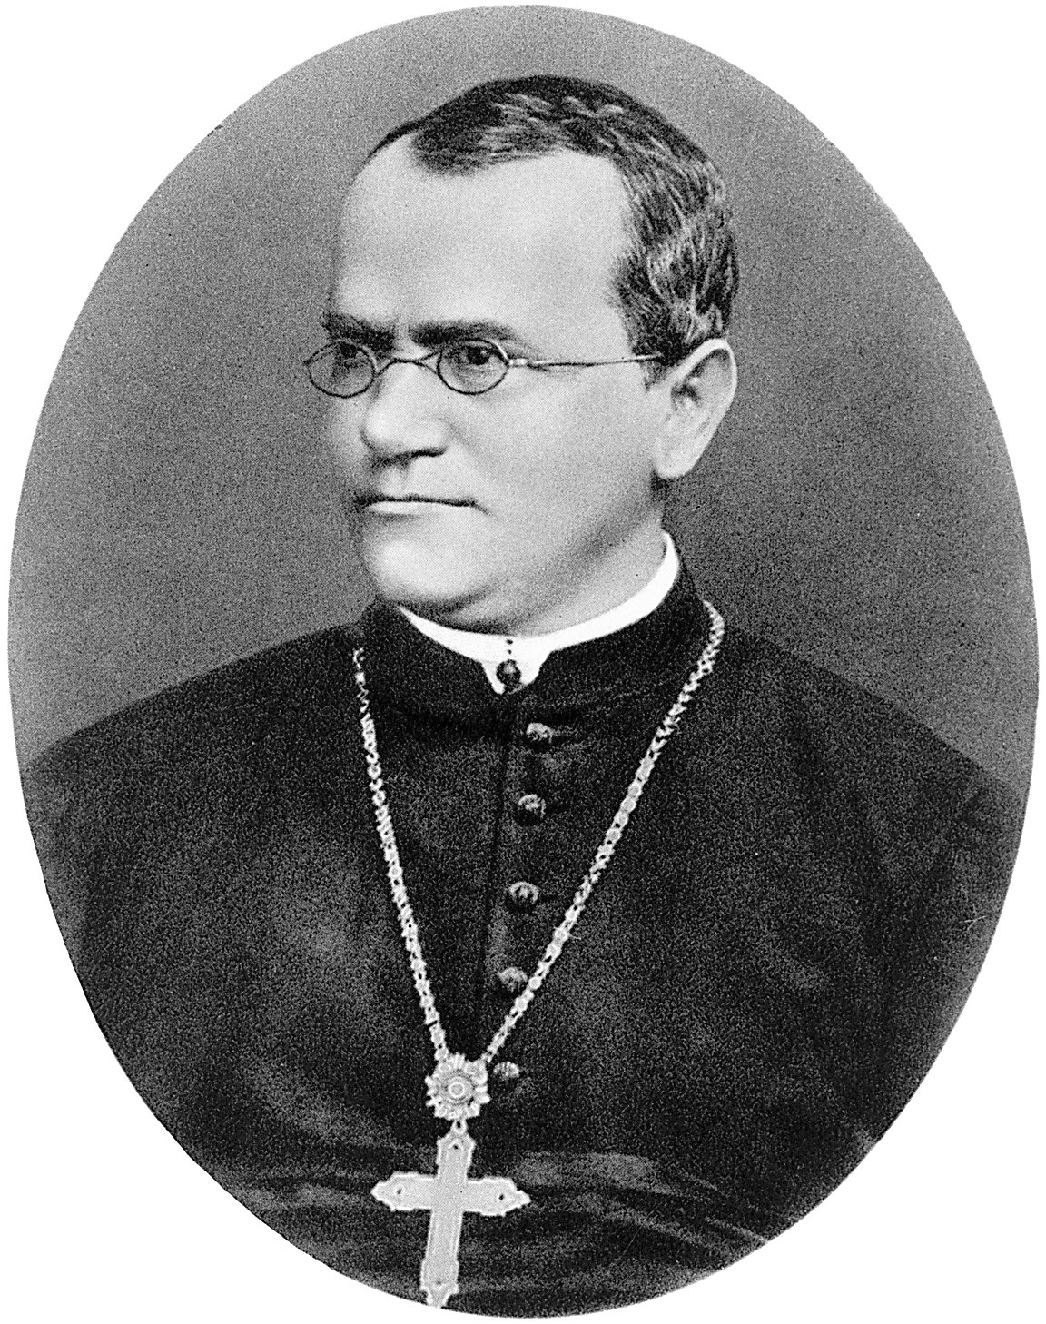
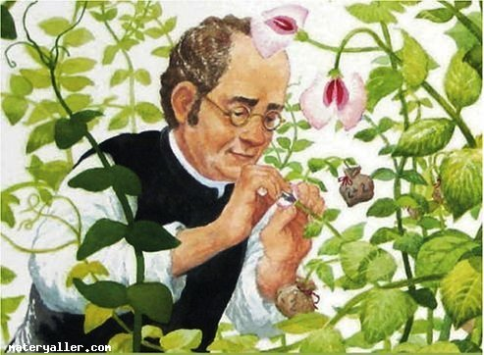
OVERVIEW
Gregor Johann Mendel(1822-1884), German-speaking Augustinian monk
The Chromosome theory of inheritance
by Thomas Hunt Morgan

Slide 3
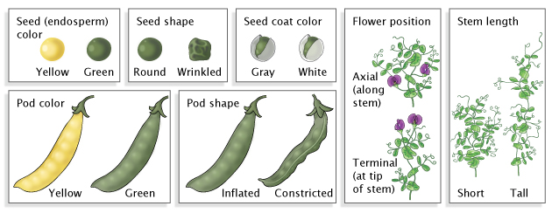
Mendel’s Law(terminology)
P : 양친, 어버이, 부모(Parents)
F1 : 자손 1세대(Filius 1)
F2 : 자손 2세대(Filius 2)
Dominant: 우성, 부모의 형질 중 F1에 나타나는 형질(대문자표시)
Recessive: 열성, 부모의 형질 중 F2에 나타나지 않는 형질(소문자표시)
Genotype: 유전형질, 형질 중 유전되는 형질
Phenotype: 표현형, 유전자가 겉으로 나타나는 모습(round pea, wrinkled pea, tall&green(TTyy), tall&yellow(TTYY))
Self-pollination: 자가수분, 같은 유전자끼리 교배시키는것(AaBb X AaBb)
Homozygote: 동형접합자, 같은 유전자로 된 개체
Heterozygote: 이형접합자, 우성과 열성이 같이 있는개체

Slide 4
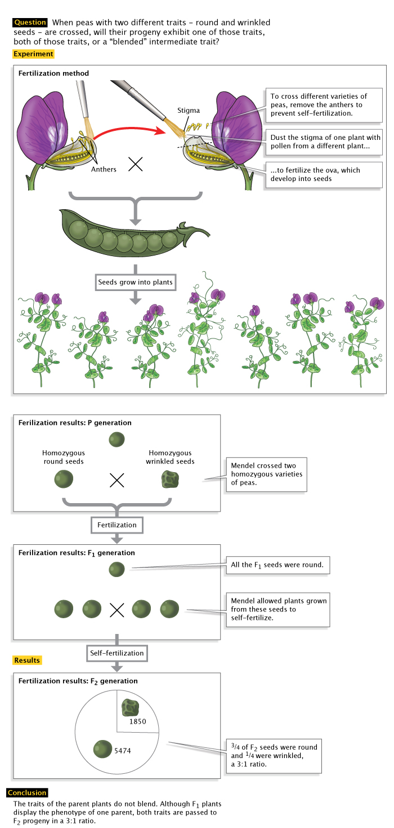
Mendel’s Law
Law | Definition
Law of Segregation | During gamete formation, the alleles for each gene segregate from each other so the each gamete carries only one allele for each gene
Law of Independent Assortment | Genes for different traits can segregate independently during the formation of gametes
Law of Dominance | Some alleles are dominant while others are recessive; an organism with at least one dominant allele will display the effect of the dominant allele.

Slide 5
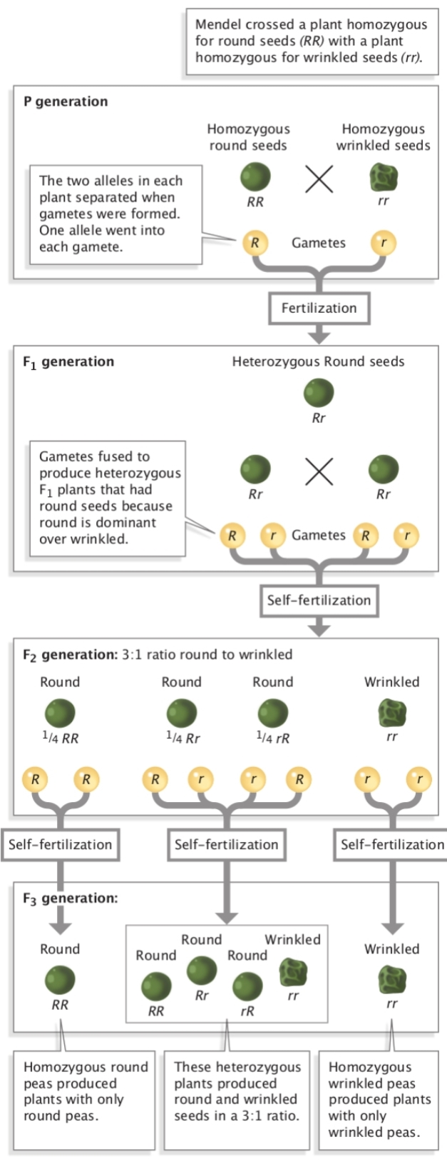
Law of Segregation (the “First Law”)
Two alleles segregate randomly during formation of gametes

Slide 6
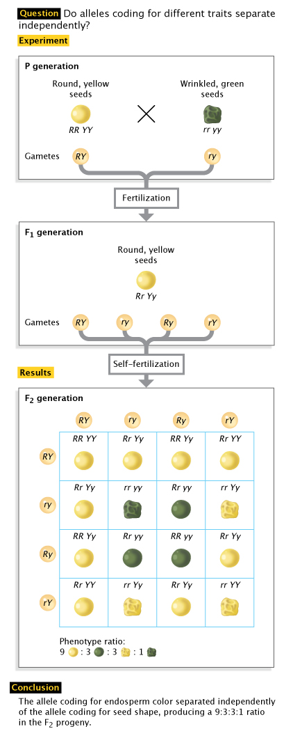
Law of Independent Assortment (the “Second Law”)
Two genes will assort independently and randomly from each other

Slide 7
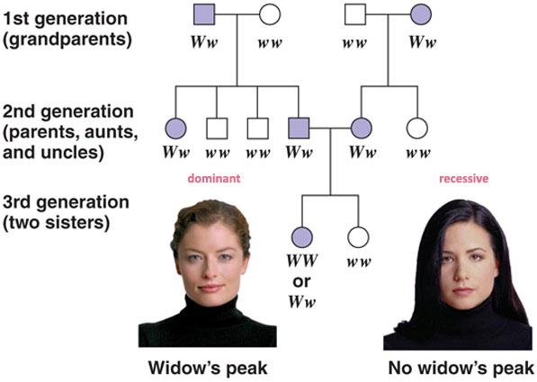
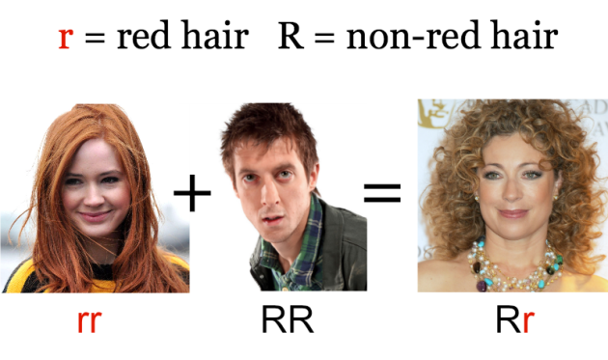
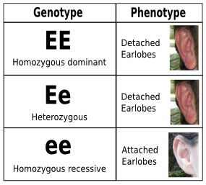
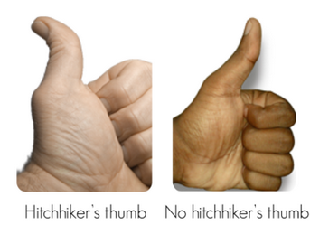
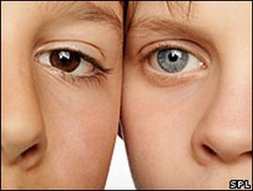
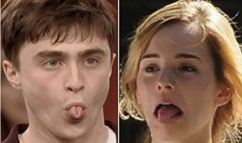
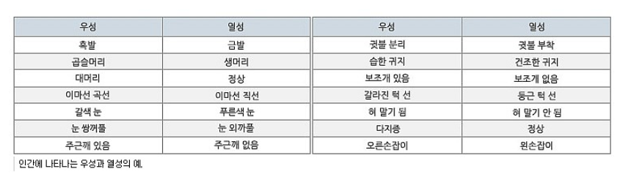
Law of Dominance (the “Third Law”)

Slide 8
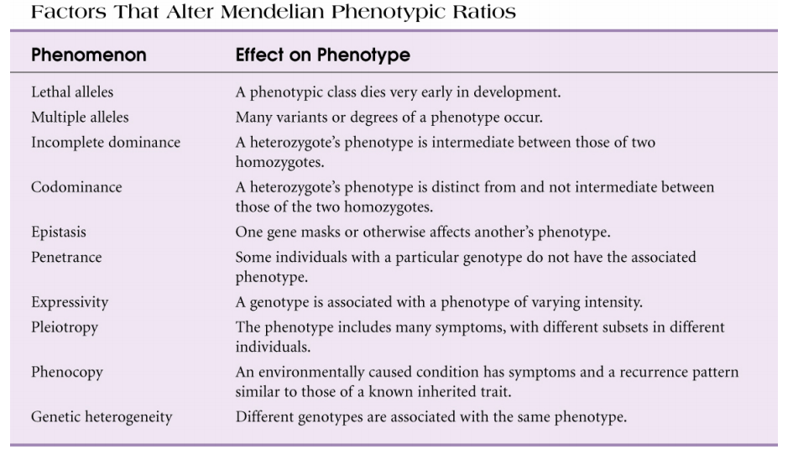
Non-Mendelian inheritance
Type1. Laws in effect
Lethal genotypes
Allelic Heterogeneity
Incomplete dominance
Co-dominance
Epistasis
Penetrance
Expressivity
Pleiotropy
Phenocopies
Genetic Heterogeneity
Type2. Mendel’s Laws no longer apply
Mitochondrial Inheritance
Linkage
Linkage Disequilibrium

Slide 9
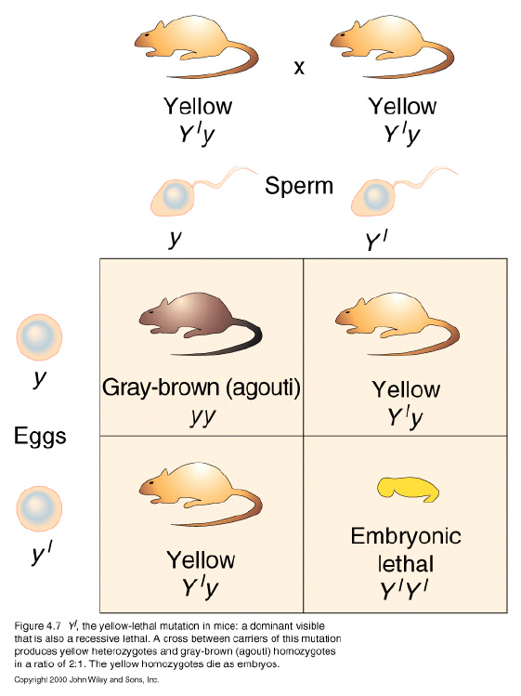
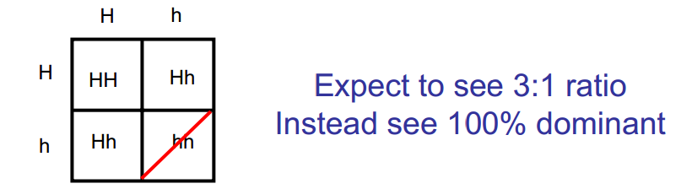
Non-Mendelian inheritance
Type1. Laws in effect(Lethal genotype)
A phenotypic class dies very early in development

Slide 10
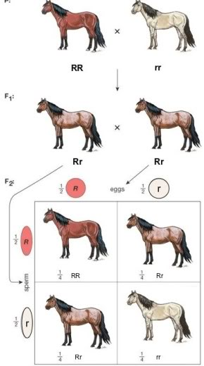
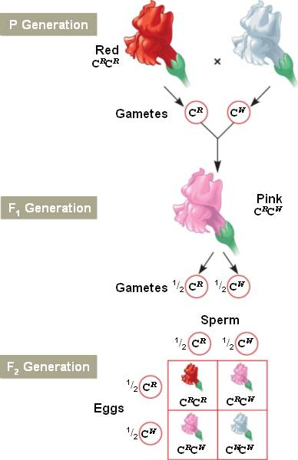
Non-Mendelian inheritance
Type1. Laws in effect(Incomplete dominance)
- A heterozygote’s phenotype is intermediate between those of two homozygotes
- One allele is not completely dominant over the other
- Can apply Law of Segregation

Slide 11
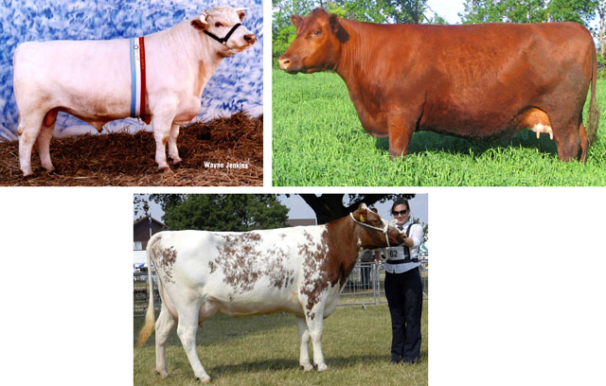

Non-Mendelian inheritance
Type1. Laws in effect(Co-dominance)
A heterozygote’s phenotype is distinct from and not intermediate between those of the two homozygotes
Phenotypic ratios are same as genotypic ratio

Slide 12
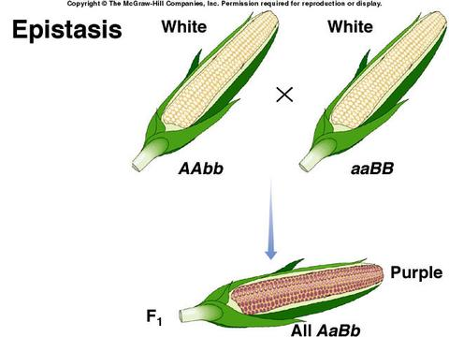
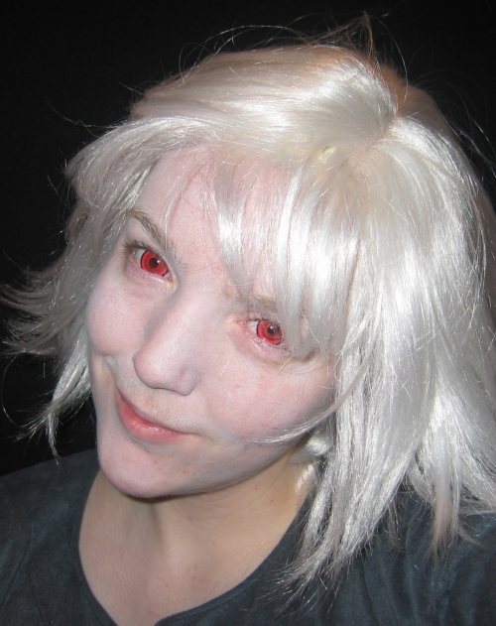
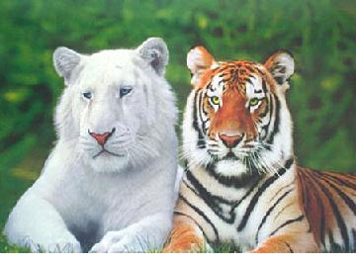
Non-Mendelian inheritance
Type1. Laws in effect(Epistasis)
One gene makes or otherwise affects another’s phenotype
Two genes interacting to affect phenotype
One gene effecting or masking another gene or two genes controlling same phenotype

Slide 13
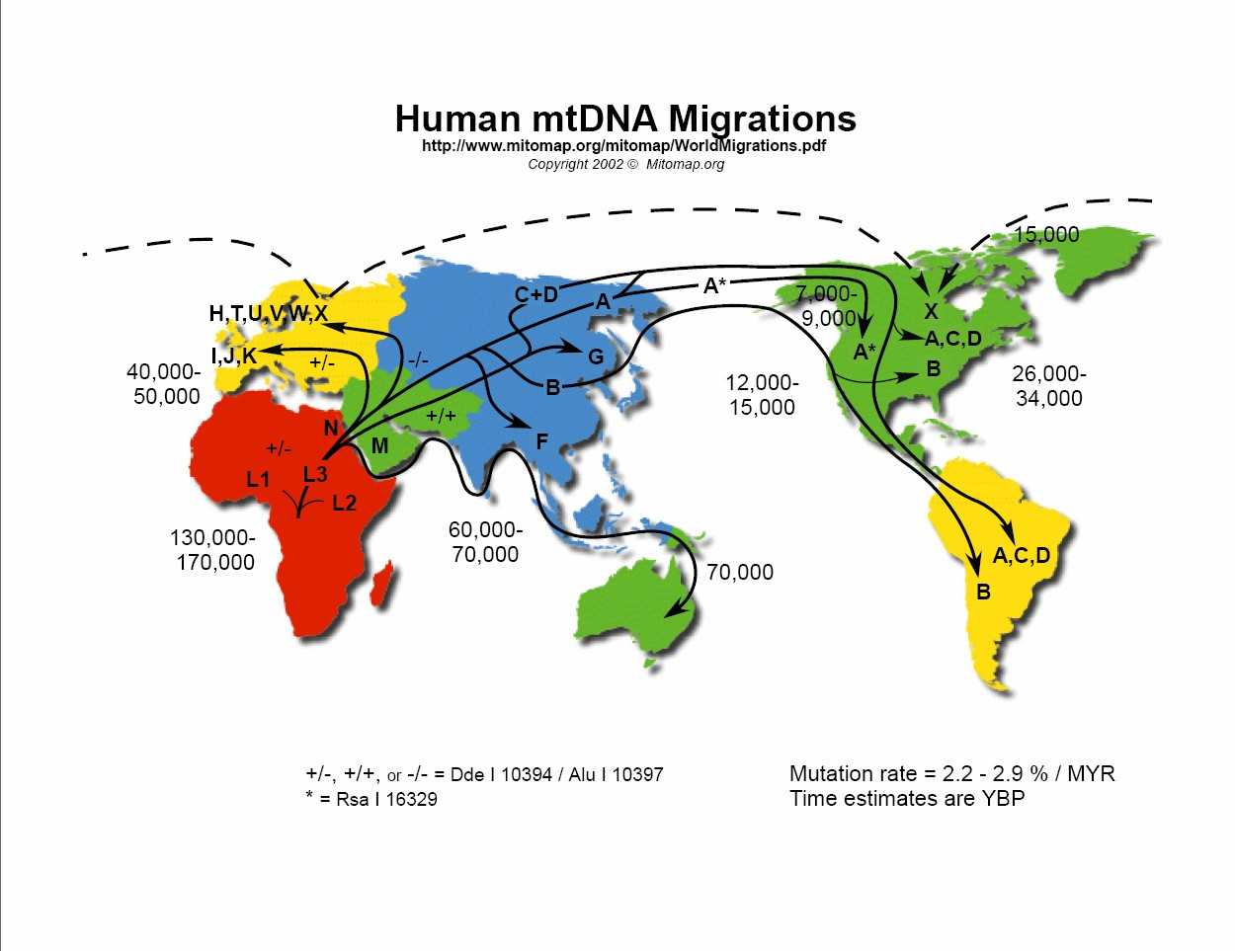
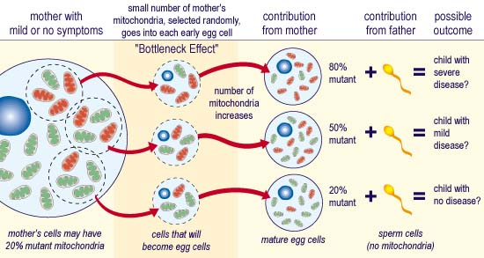
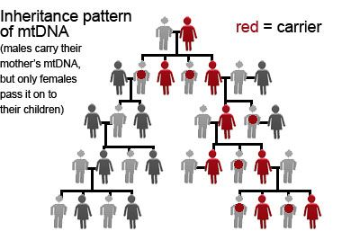
Non-Mendelian inheritance
Type2. Mendel’s Laws no longer apply(Mitochondrial Inheritance)
Mitochondria have their own DNA, which is solely maternally inherited

Slide 14
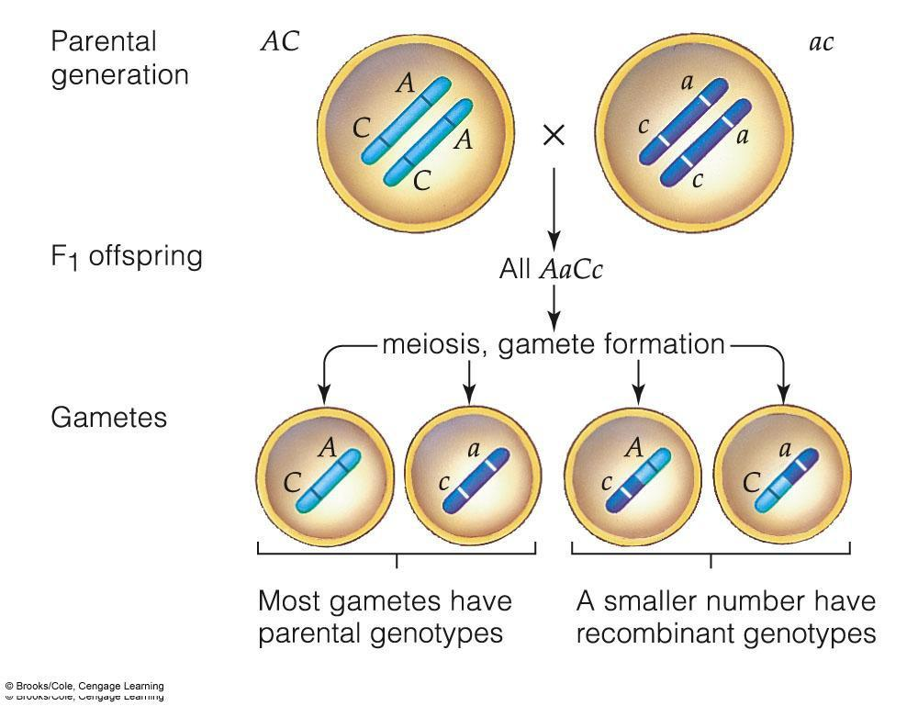
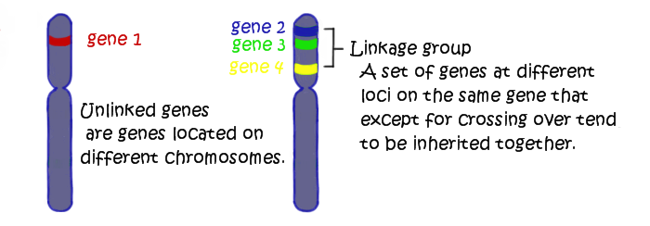
Non-Mendelian inheritance
Type2. Mendel’s Laws no longer apply(Linkage)
Two genes that are close together physically

Slide 15
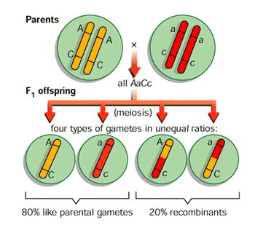
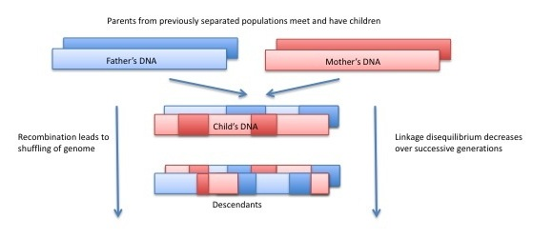
Non-Mendelian inheritance
Type2. Mendel’s Laws no longer apply(Linkage Disequilibrium)
Two alleles that are not inherited separately

Slide 16
Thank you ☺

